Slide 1
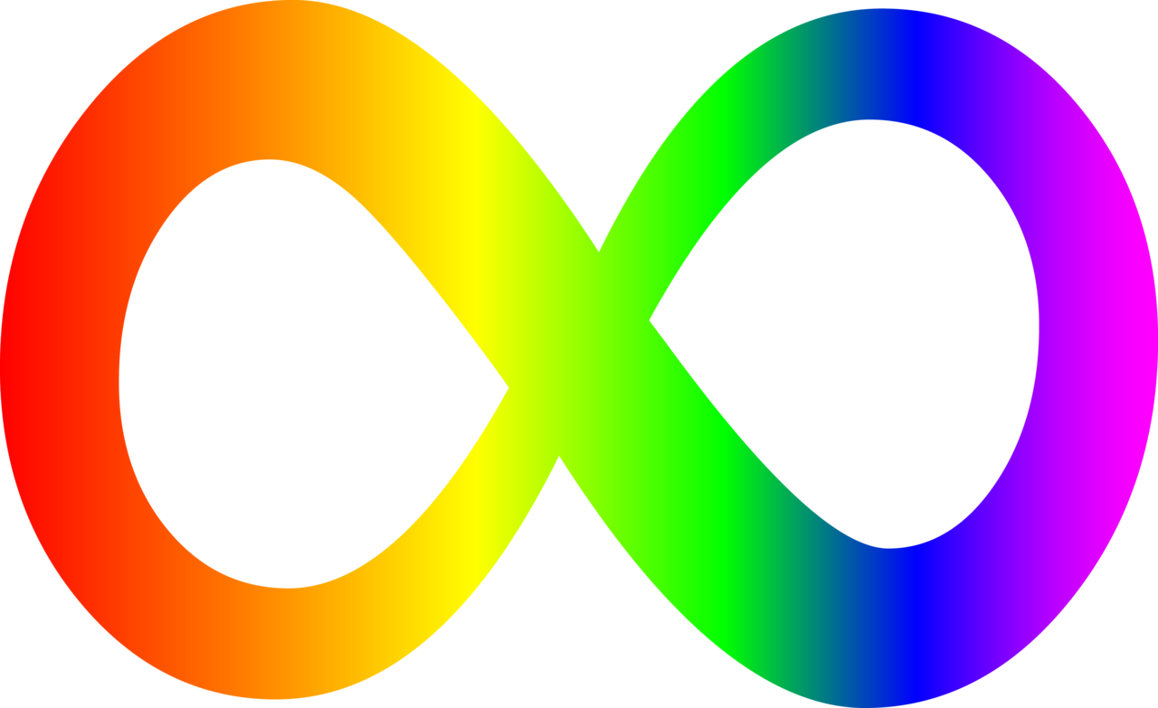
Neurodiversity: From Abnormal to Extraordinary
Notes:
Hello, this is an introductory presentation to the topic of neurodiversity. The aim of the presentation is to explain what neurodiversity means, why it matters, and how using its ideas can positively impact you and the people you interact with every day.
Image source: https://fyeahautismspectrum-blog.tumblr.com/post/5852385279

Slide 2
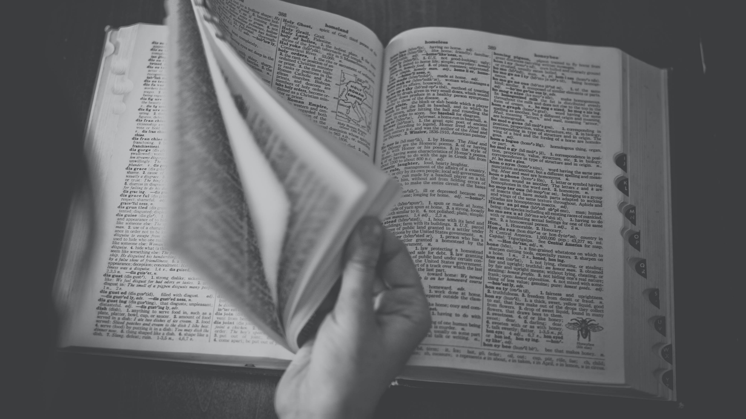
Definition
Biological fact and social movement
Acceptance of neurological differences
Diagnoses such as ADHD, autism, or dyslexia are not inherently negative
Notes:
Neurodiversity is the recognition of neurological variation as a natural aspect of the human species. The recognition of this biological fact compels a social movement to counteract the stigma and deficits-based perceptions of people labeled 'disordered' or 'disabled' because of their neurological differences. Instead of calling themselves disabled, these people say that they are neurodivergent. People that are not seen as neurologically different are called neurotypical. The concept originated out of the autism community but encompasses the wide variety of minds represented by ADHD, learning disabilities, and other diagnoses.
The neurodiversity movement does not deny the challenges that people face in their lives, but insists that those people should be the ones defining their struggles. The movement also argues that social norms and institutional biases play a role in creating these challenges for the neurodivergent. It is not the sole responsibility of the neurodivergent to conform to an inequitable society; an effort must be made to include the neurodivergent as whole persons deserving of respect.
Therefore, the neurodiversity perspective means embracing the full diversity of human minds and the validity of the neurodivergent, as well as contesting their marginalization.
Intersectionality plays a significant role in this movement, because neurodivergence exists within all races, genders, and sexualities. Recognizing the many forms of diversity and the way in which they interact is integral to understanding and supporting neurodivergent people.
Pull from here: https://www.landmark.edu/center-for-neurodiversity
https://neurocosmopolitanism.com/neurodiversity-some-basic-terms-definitions/
https://www.geniuswithin.co.uk/blog/uncategorized/whats-in-a-name-neurodiversity-neurodivergence-spld-etc/
https://www.disabled-world.com/disability/awareness/neurodiversity/#:~:text=A%20neurodivergent%20person%20is%20defined,to%20individuals%20for%20this%20purpose.
Image source: Photo by Snapwire from Pexels

Slide 3
Deficits...Aren't Everything
"Doesn't pay attention"
"Bad at spelling"
"Awkward"
"Never sits still"
"Reads too slowly"
Notes:
A common experience for neurodivergent people is that others overwhelmingly focus on their deficits. Diagnoses are made based on these deficits and people often pay more attention to those characteristics. These qualities can manifest in social, educational, and professional environments; causing frustration for the individual and making them stand out from their peers. Constant reminders of their deficits can also cause neurodivergent people to internalize that focus, only seeing how they fail to meet expectations and struggle more than others. Attempts to hide these qualities and fit in with everyone else can have its own consequences; the act of camouflaging is thought to be one cause for the correlation between neurodivergence and poorer mental health.
Image source: Photo by Andrea Piacquadio from Pexels

Slide 4
Deficits...Aren't Everything
"Artistic"
"Problem solver"
"Resilient"
"Logical"
"Funny"
Notes:
Everyone has strengths and weaknesses; it is natural to excel in some areas and struggle in others. Everyone is also deserving of respect as human beings regardless of their contributions or performance. An important part of neurodiversity is recognizing the humanity of neurodivergent people, seeing past their challenges or diagnoses. As the saying goes; "...if you only judge a fish by its ability to climb a tree, it'll live its whole life believing that its incapable of doing anything". Judging everyone by the same standards is not equitable when people can be different in so many ways. Standards and environments are often advantageous for the neurotypical over the neurodivergent; accounting for this shows respect to neurodivergent people and gives them a chance to meet their potential.
Image source: Photo by Burst from Pexels

Slide 5
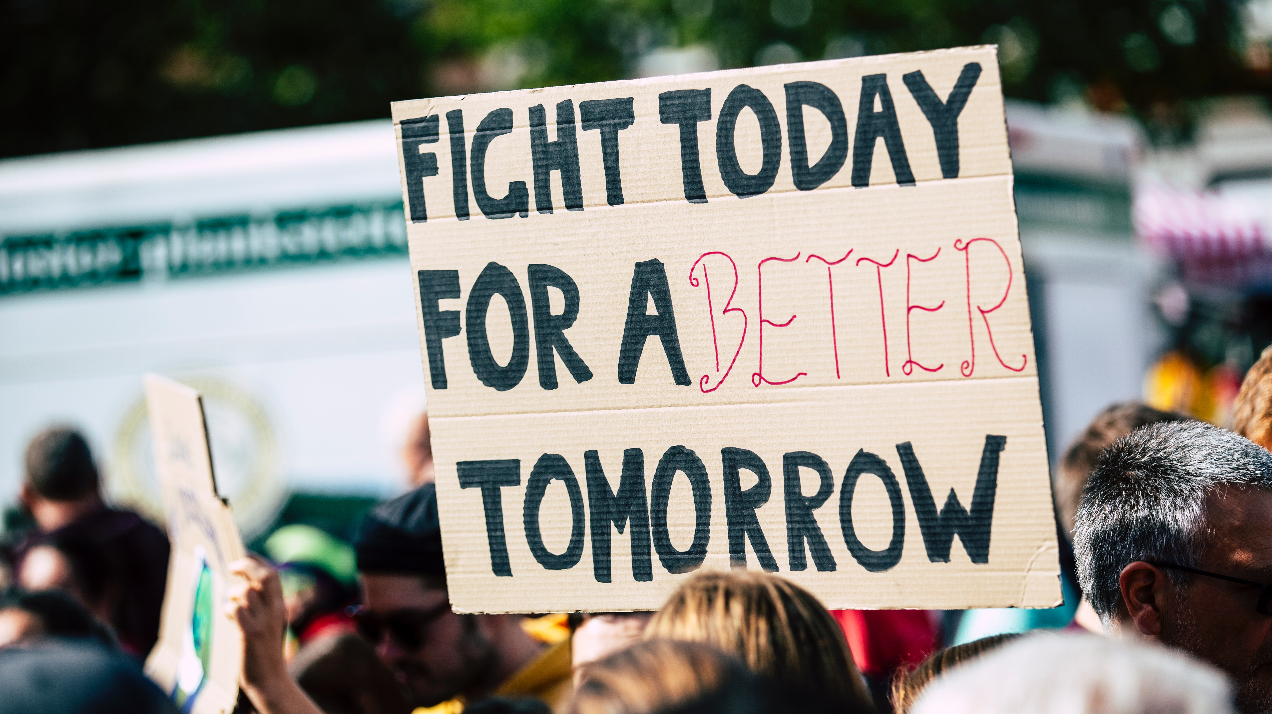
Benefits
Self-esteem
Community
Advocacy
Notes:
The neurodiversity perspective provides several benefits. It can improve the self-esteem of those that identify as neurodivergent by providing the opportunity to view one's differences positively after a lifetime of them being labeled harmful. Neurodiversity gives people the framework to be comfortable with their differences.
The neurodiversity movement also creates a sense of community and solidarity amongst otherwise separate groups. These wider circles give greater access to support and social connection for the neurodivergent. People with different diagnoses can still relate with one another; sharing this connection can be a strong benefit to those that feel isolated.
These social networks are also able to utilize the theoretical frameworks of the neurodiversity perspective to advocate for greater equity. The prospect of redefining the perception of their differences drives individuals to seek out changes in society. Self-advocacy is an integral aspect of all social movements. Neurodiversity has inspired and is driven by those individuals that stand up and demand changes in how the neurodivergent are treated.
Image source: Photo by Markus Spiske from Pexels

Slide 6
What is neurodiversity?
A biological fact
A social movement
An identity
Notes:
Let's recap the ideas that come from neurodiversity. First, neurodiversity is the biological fact that neurological variability exists naturally within the human species. Neurodiversity is also a social movement that aims to address the stigma and marginalization that neurodivergent people experience. Neurodiversity itself is not an identity, because everyone falls within the category of neurodiverse. However, those who differ from neurological norms may choose to possess neurodivergent as an identity.
Image source: Photo by Pixabay from Pexels

Slide 7
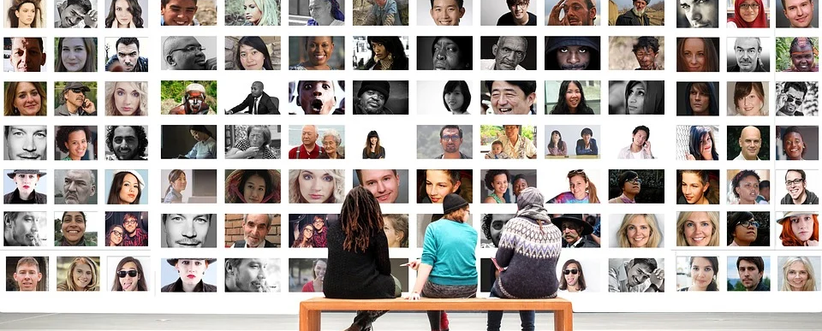
Faces of Neurodiversity
Notes:
There are many voices in the conversation about neurodiversity. Each brings a unique perspective and expertise, engaging with the movement in their own way. Looking at some of these individuals is useful for exploring the underlying concepts of neurodiversity. [find JER group photo]
Image source: Image by Gerd Altmann from Pixabay

Slide 8
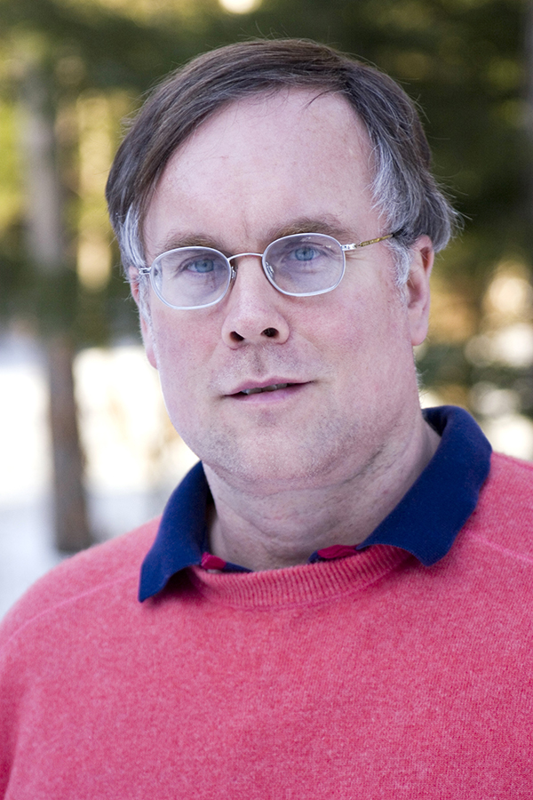
John Elder Robison
"Neurodiversity is our word. It is the answer to what other people have called us...and our word is not a word of disability."
Notes:
The neurodiversity perspective can have a strong positive impact on neurodivergent people. John Elder Robison led a remarkable life prior to being diagnosed with Asperger's at 40 years old; a high school dropout, Robison became a self-taught engineer and business owner, working on everything from custom guitars for rock bands to high-end automobile restoration. He has authored multiple books based on his experiences and is a passionate advocate for neurodiversity and the solidarity of the neurodivergent. The neurodiversity movement unites a wide range of people, making a community that values inclusion for all. Robison celebrates the solidarity that has come from this movement, saying that; "Neurodiversity is our word. It is the answer to what other people have called us...and our word is not a word of disability". The neurodiversity movement celebrates the diversity we all bring to the world and aspires to move beyond the stigma of disability.
Image source: Photo from Landmark College
https://www.landmark.edu/news/john-elder-robison-to-speak-april-9-at-landmark-college
Quote source: ~2:50 https://www.youtube.com/watch?v=KCJ27_lLmzg

Slide 9
Wolf Dunaway
"I don't want to be neurotypical. I'm happy being what I am. And I think a person who's going to come out and try and cure me because I make them uncomfortable – I think they need to deal with themselves. Because I'm not uncomfortable."
Notes:
An integral aspect of the neurodiversity movement is that the voices of the neurodivergent are predominant within it. The experts are not doctors and scientists, but the people with first-hand accounts that can speak to the lived experience of being different in a world that is often hostile to that. Wolf Dunaway speaks about his life as an autistic person in the documentary entitled Neurotypical, saying; "I don't want to be neurotypical. I'm happy being what I am. And I think a person who's going to come out and try and cure me because I make them uncomfortable – I think they need to deal with themselves. Because I'm not uncomfortable". Letting people speak for themselves is always ideal; they know what they want and how they feel. The neurodiversity movement gives the neurodivergent a platform for advocating for themselves and their needs.
Image source: Photo from Neurotypical (2013)
Description: http://archive.pov.org/neurotypical/film-description/
Dunaway's own review of documentary: https://www.amazon.com/gp/customer-reviews/R2VMW2QRNSM9T1/ref=cm_cr_arp_d_rvw_ttl?ie=UTF8&ASIN=B00HGIL9Y0
Article featuring Dunaway with video: https://www.wbaltv.com/article/redefining-what-it-means-to-live-with-autism/9621874

Slide 10
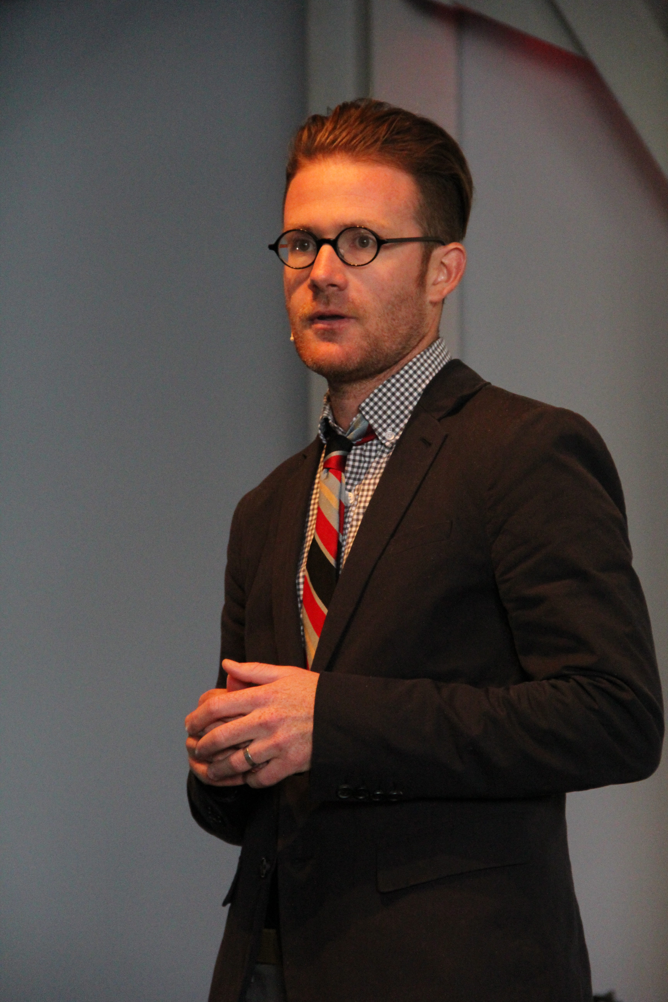
Jonathon Mooney
"Differences are fact. Difference is essential. In fact, it drives life on earth. It requires us to include and to love...the round peg, even when it doesn’t fit the square hole."
Notes:
The preconceived notion that issues faced by neurodivergent people originate solely from the individual is challenged by activists such as Jonathon Mooney. Growing up with dyslexia and ADHD, Mooney knows what it's like to not be 'normal', but he argues that this conception of normal that haunts those seen as different is illegitimate, stating that; "Differences are fact. Difference is essential. In fact, it drives life on earth. It requires us to include and to love...the round peg, even when it doesn’t fit the square hole". According to the neurodiversity perspective all minds are valid; and so when a round peg meets a square hole, or a student fails despite doing their best, it is the environment that needs to be put under scrutiny.
Image source: Photo by Tara Griffith from TEDx Santa Monica
Quote source: https://www.nytimes.com/2019/10/09/opinion/learning-disability.html

Slide 11
Lydia X. Z. Brown
"...we have infinitely diverse possibilities for how we move through the world and craft our own lives. And that because of that, our experiences as disabled, as neurodivergent...are in fact part of the fabric of human diversity."
Notes:
The neurodiversity movement is also about social justice; combating ableism and advocating for the neurodivergent. Lydia X. Z. Brown is one such activist that advances this cause. A disability justice advocate, Brown's work incorporates intersectionality by also accounting for other aspects of identity that face marginalization such as race and gender. Brown states that; "...we have infinitely diverse possibilities for how we move through the world and craft our own lives. And that because of that, our experiences as disabled, as neurodivergent...are in fact part of the fabric of human diversity“. Brown condemns the oppressive institutions that impact all marginalized groups. As a movement for social justice, neurodiversity exists alongside other movements for marginalized identities and shares many of their members. Intersectionality is imperative for a movement that transcends race, gender, and sexual orientation. The first step is recognizing that everyone experiences the world differently, and that those experiences are valid.
Image source: Photo by Adam Glanzman/Northeastern University from autistichoya.net
Quote source: ~24:30 https://www.youtube.com/watch?v=kwivWC6-WbQ

Slide 12
Greta Thunberg
"I have Asperger’s syndrome and that means I’m sometimes a bit different from the norm. And - given the right circumstances - being different is a superpower."
Notes:
Greta Thunberg is an environmental activist and advocate for the neurodiversity perspective. Reflecting on her diagnosis, she states; "I have Asperger’s syndrome and that means I’m sometimes a bit different from the norm. And - given the right circumstances - being different is a superpower". Thunberg believes that her accomplishments have been because of her differences, not in spite of them. This is the neurodiversity perspective in action. These ideas are not just about making people feel better, but helping them to reach their full potential. Individuals like Thunberg show that being 'abnormal' doesn't stop people from being extraordinary.
Quote source: https://www.instagram.com/p/B12ChnkioB9/?utm_source=ig_embed
Video with her elaborating on quote: https://www.cbsnews.com/video/greta-thunberg-on-the-advantage-of-aspergers-in-fighting-climate-change-we-need-people-who-think-outside-the-box/
Image source: Photo by Jan Ainali from Wikipedia

Slide 13
Going Forward
Notes:
There are several concrete actions you can take to incorporate these ideas into your life. Whether you consider yourself neurodivergent or neurotypical, you should hold onto these ideas and practice them with yourself and others.
Image source: Photo by Helena Lopes from Pexels

Slide 14
Value Difference
Notes:
First, value the ways in which everyone is different. Whether you're hanging out with friends or working on a group project with co-workers, appreciate the contributions that everyone brings and anticipate the ways you can support others. Employers should recognize that everyone requires different resources to be successful, and being responsive to those needs creates an inclusive and productive work environment. Teachers need to go beyond reacting to required accommodations for individual students. Organize the classroom and structure lessons in a way that pays respect to all student learning profiles; this will make your neurodivergent students feel welcomed in the space and more confident as learners.
Image source: Photo by Jeshu John from DesignersPics

Slide 15
Be Accepting
Notes:
Second, practice being accepting and promote that attitude for others. Refrain from disparaging or dismissing someone that thinks or acts in a way you don't understand. And speak up if you or someone else is the target of prejudice for being neurodivergent. It is important to be proactive, finding ways to signal your acceptance will help more people than you realize. Displaying the rainbow infinity symbol is one simple method, and can be a good conversation-starter for telling others about neurodiversity. Remember: the human race is diverse. And like all forms of diversity, neurodiversity is not just valid but beneficial to us all.
Image source: Photo by Jeshu John from DesignersPics

Slide 16
Appreciate Yourself
Notes:
Finally, whether or not you identify as neurodivergent, take the time to appreciate your own neurological characteristics that make you stand out from the crowd. Being confident in yourself will make you an example for others to follow. Instead of beating yourself up when you struggle, find ways to compensate and take advantage of your strengths. Recall the advocates previously discussed in this presentation; what they all shared in common was that they celebrated their differences as strengths. Do the same for yourself, because the world is a more vibrant place from you being in it, and that is something to take pride in.
Image source: Photo by Matheus Natan from Pexels

Slide 17
Closing Thoughts
Notes:
Take a minute to consider what you've learned from this presentation. How can you apply this knowledge to your everyday life? What immediate impact would this application have on yourself and the people around you? What would be the wider effect of these ideas being adopted by more people in society? Reflect on the far-reaching potential of neurodiversity. Discuss these ideas with friends and colleagues. And in a world that stifles difference, strive to be extraordinary.
Image source: Photo by Min An from Pexels

Slide 18
Acknowledgements
Created and presented by: Steven Vitt, Landmark College graduate and Center for Neurodiversity intern
Special thanks to: Solvegi Shmulsky, Center for Neurodiversity Director
Distributed by Landmark College’s Center for Neurodiversity.
For more information, visit the Center for Neurodiversity webpage at landmark.edu/center-for-neurodiversity or contact Center Director Solvegi Shmulsky at: sshmulsky@landmark.edu
This presentation has not been endorsed by the featured individuals nor does their inclusion represent an endorsement of them by Landmark College or the Center for Neurodiversity.

