Slide 1
Roundtable -
Access to Education Abroad for All:
Serving Students with Anxiety, Autism & More

Slide 2
Agenda
Introductions Who are we? Who are you? What will you learn today?
Autism and Anxiety Diagnostic criteria; what you might observe
Pre-departure Strategies for program marketing and student outreach
On-site support Strategies to help students succeed
Expanding Access Disclosure and student support on-campus
Notes:
Susan

Slide 3
Presenters
Susan Holme, Director of Off-Campus Studies, Whitman College
(MA in Asian Studies)
Andy Donahue, Director of Social Pragmatics, Landmark College
(Licensed Clinical Mental Health Counselor)
Jessica Lindoerfer, Director of Experiential Education, Landmark College
(MA in International Education)
Antonia Keithahn, Associate Director of Academic Resources, Whitman College
(MA in Education)
Notes:
Each person introduces themself

Slide 4
Introduce yourselves
In the Chat…
Institution/Organization
Your role
Why you are interested in this topic
Notes:
Susan

Slide 5

Whitman College
Type: Private Liberal Arts
Degrees: Bachelor of Arts
Enrollment: 1540 undergraduates
Study Abroad Programming: 80 semester & year-long options via providers and overseas universities
Study Abroad Enrollment: 200 per year (pre-COVID)
Location: Walla Walla, Washington
Notes:
Susan

Slide 6

Landmark College
Type: Private, serves students who learn differently including students with a learning disability (such as dyslexia), ADHD or autism spectrum disorder (ASD)
Degrees: Associate and Bachelors
Enrollment: 400 undergraduates
Study Abroad Programming: 5-6 Faculty-led
programs
Study Abroad Enrollment: 60 per year (pre-COVID)
Location: Putney, Vermont
Notes:
Jess
Landmark example is unique - culture of disclosure and availability of diagnosis information; accommodations worked into all areas of campus life

Slide 7
Topic Introduction
Why we chose this topic
Are ASD and Anxiety the same? Why are we putting them together?

Slide 8
Goals for today
Knowledge
Understand how autism and anxiety affect students
Learn how another school has created education abroad opportunities for neurodiverse students
Skills
Identify aspects of your programs that may create challenges for neurodiverse students
Identify ways to mitigate these challenges through program design and student support
Develop strategies for how study abroad offices can provide support for neuro-diverse students and evaluate potential study abroad sites with their needs in mind
Notes:
Susan

Slide 9
A note on language
We will be using primarily identity-first language in this presentation. An example would be “autistic student” rather than “student with autism.”
Why?
Identity-first language is strongly preferred in the disability and neurodiverse community
It centers disability/neurodiversity as a core piece of someone’s identity and lived experiences
NB: An individual may prefer other language to describe themselves. You should make every effort to note the language a student uses and reflect that back in speaking with them.
Notes:
Antonia

Slide 10
Autism in the Diagnostic and Statistical Manual of Mental Disorders (DSM)
DSM (1952) and DSM II (1968)
“autistic” behavior associated with schizophrenia in childhood
DSM III (1980)
Infantile Autism
diagnosis distinct from schizophrenia
DSM IIIR (1987) and DSM IV (1994)
Autistic Disorder
four subcategories including Asperger’s & Pervasive Developmental Disorder
DSM V (2013)
Autism Spectrum Disorder
If diagnosed at age 5, current age:
47-74 14-39 40-46 <14
source: https://blogs.uoregon.edu/autismhistoryproject/topics/autism-in-the-dsm/
Notes:
Andy

Slide 11
Diagnostic Criteria: Autism Spectrum Disorder
A: Persistent Deficits in Social Communication and Social Interaction
Difficulty with back-and-forth conversation
Doesn’t share emotions or affect
Lack of eye contact or body language, lack of facial expressions
Struggles to adapt to different social situations
Difficulty understanding, developing, or maintaining relationships
Notes:
Andy

Slide 12
Diagnostic Criteria: Autism Spectrum Disorder (cont.)
B: Restricted, Repetitive Patterns of Behavior, Interests, or Activities
Overly sensitive to (or interested in) sensory stimulation, e.g. sounds, temperatures, lights, textures
Adheres rigidly to routines; difficulty with change or transitions
Intensely focused or perseverative interests
Repetitive motions or speech
Notes:
Andy

Slide 13
Anxiety Disorders in the DSM-V
Generalized Anxiety Disorder
Obsessive Compulsive Disorder
Panic Disorder
Post Traumatic Stress Disorder
Social Phobia / Social Anxiety Disorder
source: https://www.verywellmind.com/dsm-5-criteria-for-generalized-anxiety-disorder-1393147
Notes:
Andy

Slide 14
Diagnostic Criteria: Generalized Anxiety Disorder
The presence of excessive anxiety and worry about a variety of topics, events, or activities. (Usually occurs for at least six months)
The worry is difficult to control, and can shift from one topic to another
At least three of the following physical symptoms: restlessness, tiring easily, impaired concentration, irritability, muscle aches or soreness, difficulty sleeping
source: https://www.verywellmind.com/dsm-5-criteria-for-generalized-anxiety-disorder-1393147
Notes:
Andy

Slide 15

Questions about diagnoses?

Slide 16
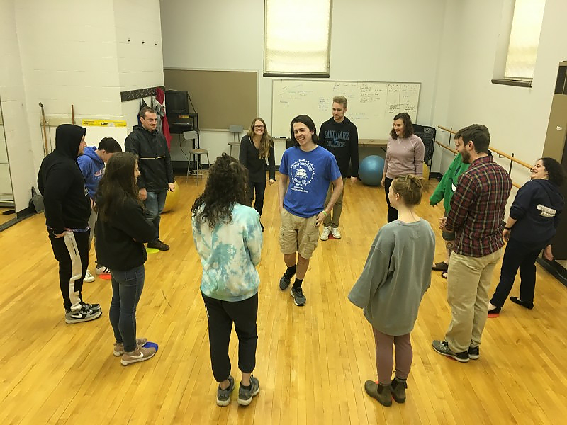
Pre-Departure
Program Marketing and Outreach
Working with students

Slide 17
Know your programs!
 | Supportive | Challenging
Change/transitions | Very few (or no) transitions; regular day-to-day routine | Program moves around a lot; variable schedule
Sensory input | Ability to minimize exposure to loud/chaotic environments (bright lights, temperature extremes, loud noises) | Navigation in crowded cities, loud/busy program center, extreme heat or cold
Housing | Comfortable, low-sensory environments | Crowded, rowdy housing arrangements
Independence | Opportunities for exploration with plenty of support and guidance available | High degree of independence
Notes:
Jess
May not be dealbreakers!

Slide 18
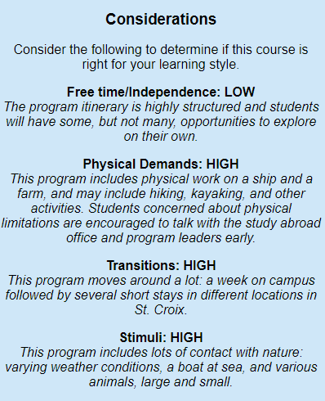
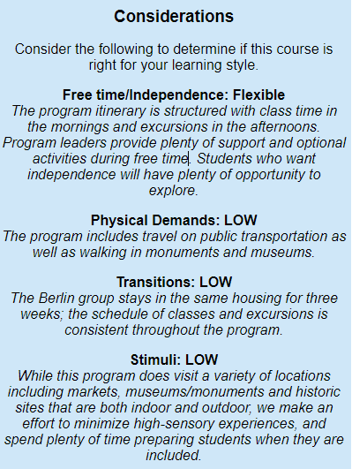
Program description and promotion
St. Croix, USVI
Internatural Communication
Berlin, Germany
Cities at War
Notes:
Jess
May not be dealbreakers!

Slide 19
Pre-Departure: What we may see
Avoid loud, crowded info events
Provide individualized support
Specific outreach to student groups
Overwhelmed with choices
Notes:
Jess

Slide 20
Pre-Departure: What we may see (part one)
Repeated questions or focus on details
Provide as much info as possible ahead of time
Answer questions; be patient
Useful fodder for discussion about support
Notes:
Jess

Slide 21
Pre-Departure: What we may see (part two)
Interviews: low affect, brief responses
Be clear about expectations / purpose
Be patient; prompt for more information
Offer choices and ask for elaboration
Notes:
Jess

Slide 22
Pre-Departure: What we may see (part three)
Reticence in pre-departure activities
Explain events in advance
Offer the opportunity to observe
Find moments for one-on-one support
Notes:
Jess

Slide 23
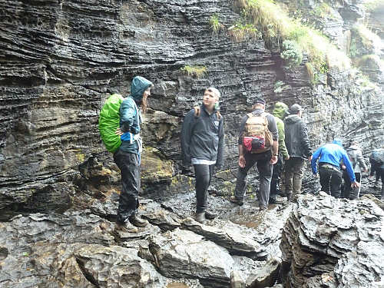
Access to Education Abroad for All?

Slide 24
Questions about pre-departure?

Slide 25
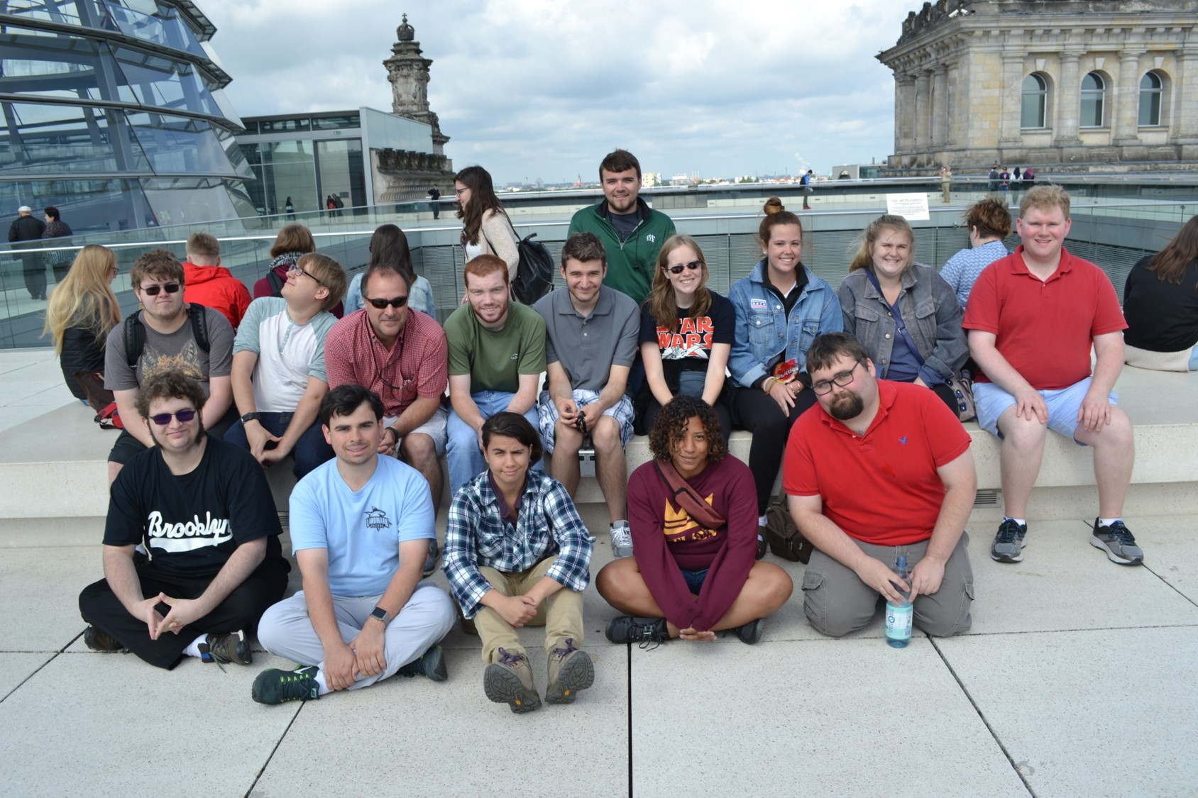
On-site
Working proactively to anticipate challenges
Helping students make the most of their experiences
-Academics-
-Social-
Notes:
Andy

Slide 26
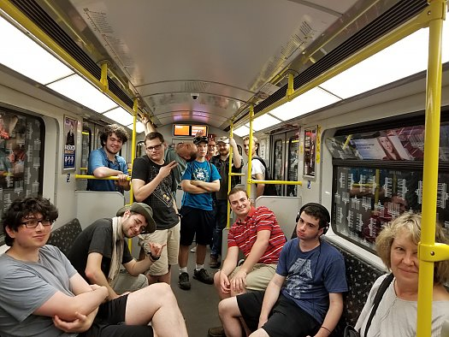
Program Elements that may be challenging
High-sensory program activities and busy, long days
Tips:
Preview, preview, preview!
Plan a strategy for coping
Be deliberate in incorporating down time
Notes:
Andy

Slide 27
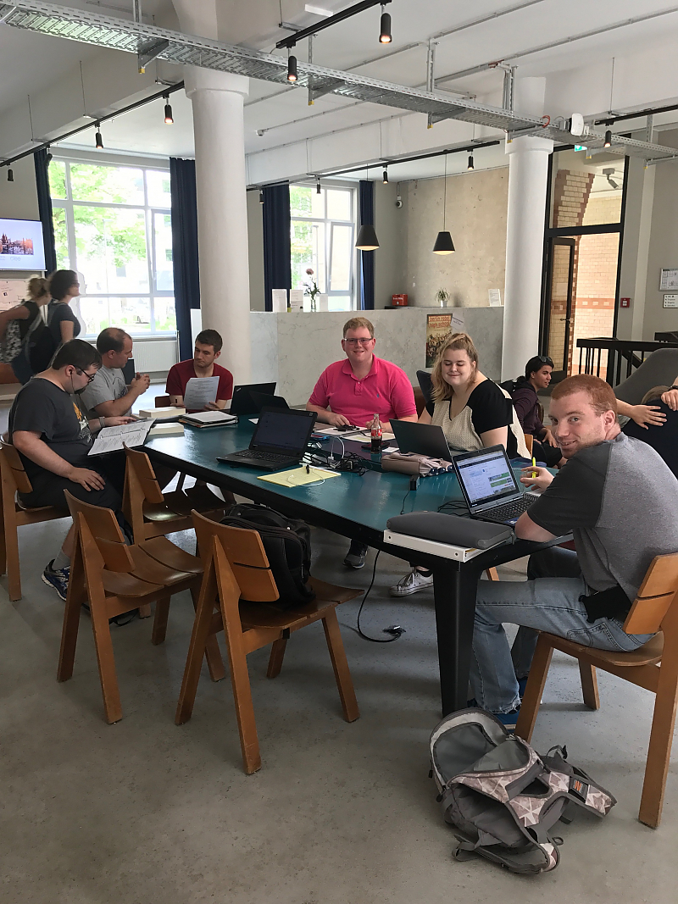
Program Elements that may be challenging -1
Academic demands
Tips:
Ensure academic support is available
Use principles of Universal Design for Learning
Notes:
Andy

Slide 28
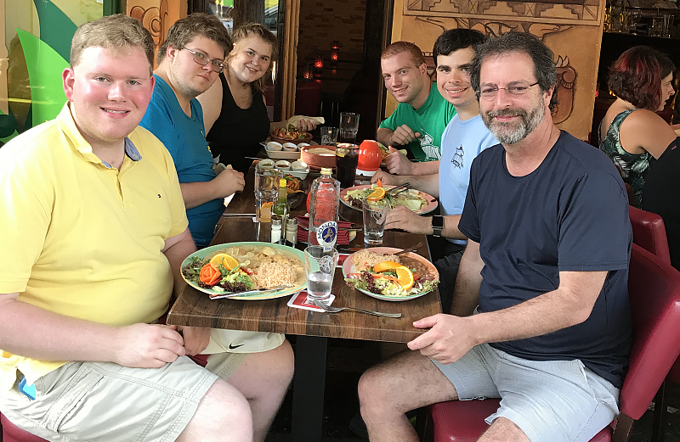
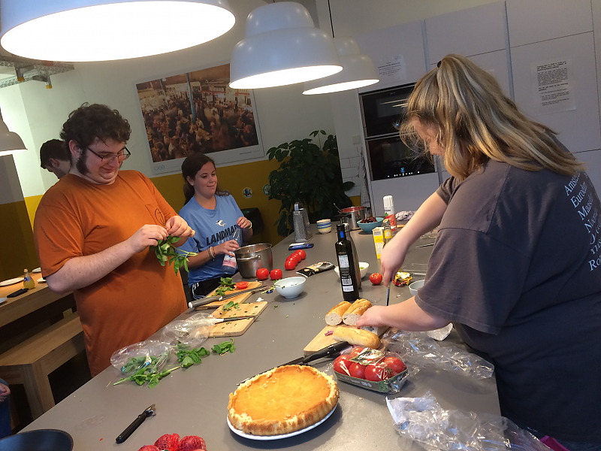
Program Elements that may be challenging-2
Cultural differences, including food
Tips:
Discuss difference and what to expect
Provide opportunities for self-catering
Encourage students to try new things
Include plenty of choice
Notes:
Andy

Slide 29

Program Elements that may be challenging-3
Social issues with peers
Tips:
Encourage communication
Mix and match groups
Notes:
Andy

Slide 30
Questions about on-site support?

Slide 31
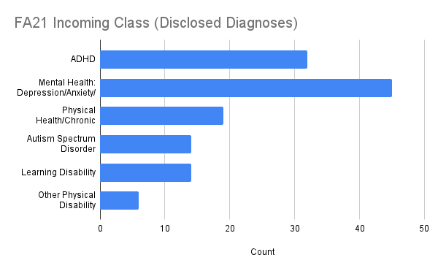
Expanding Access
Shifting Demographics: Whitman College
Disability Support Services
Fall 2015: 7.5% of students
Fall 2021: 16% of students
Marked increases in diagnoses of Generalized Anxiety Disorder, sometimes in combination with other mental health diagnoses, as well as ASD

Slide 32
Expanding Access
Why have overall numbers changed at Whitman?
Greater understanding and early intervention for many students
Improved and expanded services and treatments
National diagnostic trends
  https://www.nytimes.com/2019/02/21/education/learning/mental-health-counseling-on-campus.html
Responding to students’ lived experiences in assessing eligibility for accommodations

Slide 33
Thinking Beyond Diagnoses
While diagnoses are important they don’t represent the entire picture.
Reasons why we should be responsive to student needs and recognize/rethink barriers in processes, curriculum, etc:
Financial barriers (a full report can be a prohibitive expense)
Cultural and/or familial barriers
Other marginalized identities
Limited diagnostic categories or diagnostic impressions
Access or location barriers
Self-ableism

Slide 34
Disclosure vs. Needs
Questions that prompt only a diagnostic disclosure may be a pitfall for both the student and the EA office. Why is it important to be more holistic (yet still highly specific!) with your questions?
Asking diagnosis-specific questions may exclude certain students
Some disabilities present differently in different situations, so it is important to get the complete picture
A student may focus on one diagnosis and not speak to other barriers or needs
A student may not feel comfortable disclosing to an EA adviser and leave out critical information because they don’t have an inclusive space to speak to their access needs

Slide 35
Other ways to model inclusion
Avoid euphemistic language, such as “special needs”
  This terminology both serves to alienate disabled students and may dissuade pre-diagnosed or undiagnosed students from describing their needs
Use specific examples in question prompts
  This will help you get the most complete information and demonstrate to students that you’ve considered the whole person in creating your materials
Connect with students about your own access needs when travelling, only if you feel comfortable doing so
  For example, I take a daily controlled medication and have to plan ahead when I travel, and also have dietary restrictions. Your sharing may help a student open up about their needs and concerns.

Slide 36
Multiple Marginalized Identities
More holistic questions will also help OCS staff support multiple aspects of a student’s identity or be better placed to advise a student.
Disability and Neurodivergence can be present alongside other identities such as race and ethnicity, gender/sexuality, socioeconomic status, religious practice, as well as multiple disabilities or chronic health needs.
Depending on the nature of an off-campus experience, the most salient identity may shift based on context, so addressing all will give the student the necessary skill set to navigate those intersecting needs.

Slide 37
Partnering with DSS Offices
How can Education Abroad/Off-Campus Study offices and Disability/Access Centers work together to support students?
Collaboration on Program reviews and descriptions
  Identify potential barriers and opportunities in your Program offerings
Release of Information
  A ROI signed by the student can allow identified staff members to work together with permission from the student
General Advice
  While a DSS Counselor may not be able to disclose a student’s disability, they can prompt particular questions or offer general information about how they might counsel a student with an equivalent diagnosis

Slide 38
Questions about expanding access?

Slide 39
Discussion Topics
Case study. Your institution administers a semester-long program on public health in China. What aspects of the program can be tweaked to accommodate neurodiverse students or students with anxiety? What are some activities/settings that might create challenges? What aspects might be challenging that cannot be changed?
Case study. You are a study abroad adviser and you meet with a student who is socially awkward, not making eye contact and providing very brief answers to your questions. You are having a difficult time eliciting responses from the student to help determine what type of program would be suitable. The student has not disclosed any medical needs or learning accommodation. How would you proceed? What, if anything, should be communicated to EA sponsors of programs the student is considering?
Training. On your campuses/program sites, what training or discussions should happen in order for faculty and staff to feel confident working with neurodiverse students or students with anxiety?

Slide 40
Thanks very much for joining us
and for your work toward more inclusive
Education Abroad!

