Slide 1
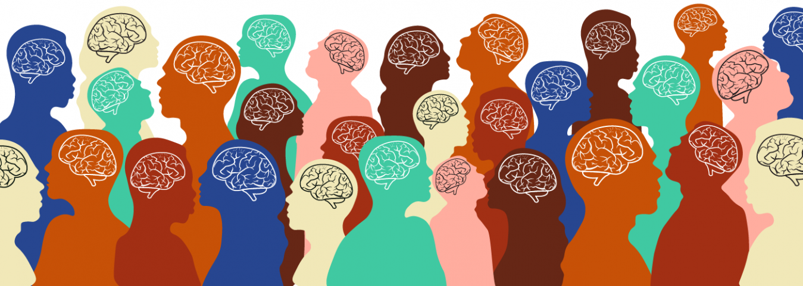
Adapting cbt for neurodiversity
Emily King
Spring 2021
Notes:
Good afternoon, my name is Emily King and today I will be sharing my application project with you entitled, “Adapting cognitive behavioral therapy for neurodiversity.”

Slide 2
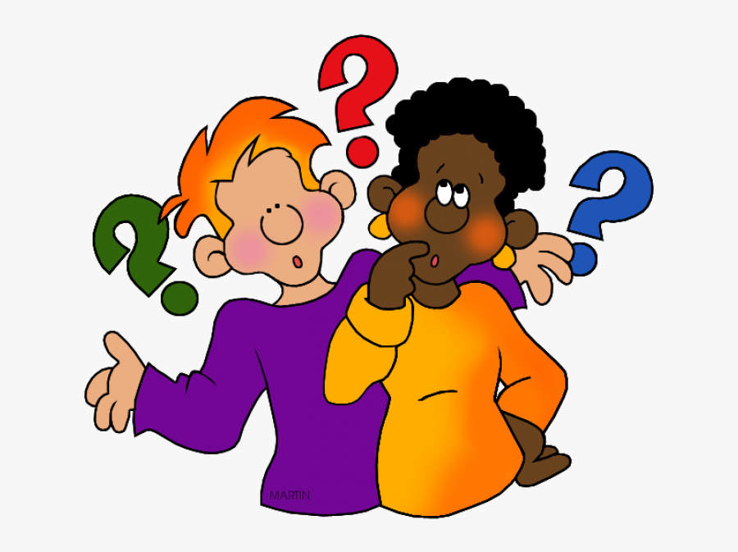
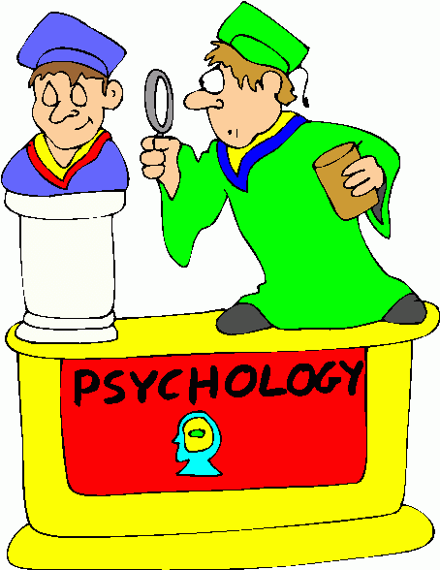
Why psychology?
General Interest in How we Think and Act
Answering Questions
Helping Others
Goal: Clinical Psychology with an Emphasis on Psychopathology and Neurodiversity
Notes:
I think an important part to start off with is why did I choose psychology as my major? Perhaps I was drawn to it because I had so many questions about why humans do the things that they do. Rene Day-Cart was famous for his philosophy “Co-gjeto air-go soom”, “I think, therefore I am”, which defines consciousness as our ability to question out surroundings, and I think I’ve always had this Day-cart-esian way of thinking. I also love how psychology can be used to not only learn more about ourselves, but can be used to help others. My professional goal is to go to graduate school to study clinical psychology with an emphasis on psychopathology and neurodiversity, specifically how mental illness manifests itself in those who are neurodiverse.
Photo Credits:
Students Asking Questions https://www.clipartkey.com/view/iooJhR_student-asking-question-clipart/
Psychologist Clip Art http://www.clipartpanda.com/categories/psychologist-20clipart

Slide 3
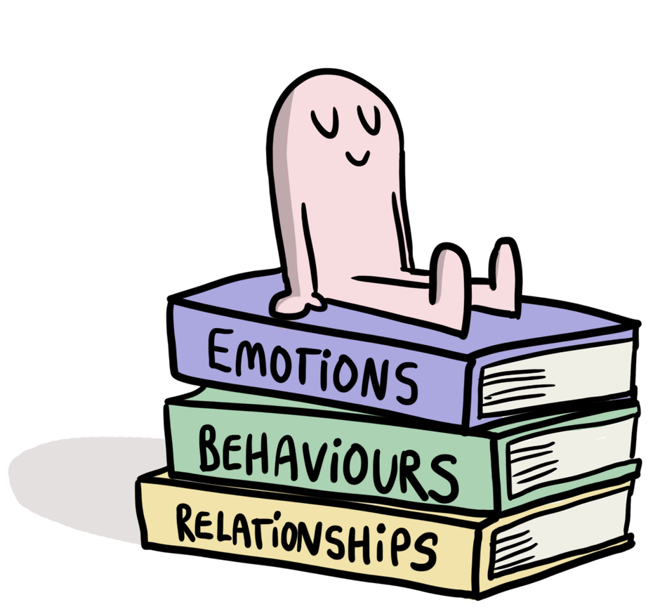
Why do we do what we do?
Combination of Nature and Nurture
Socio-cultural Aspects
Behavioral Aspects
Development Aspects
Notes:
I’ve always felt that human behavior can be attributed to both nature and nurture: it is not just our genetics or our upbringing that shape us into the people that we are, it’s a combination. I also believe that behavior and thinking stems largely from socio-cultural aspects, behavioral aspects, and developmental aspects. For example, if someone has depression, it could be that they are genetically predisposed to the disorder, but it also could result from them being rejected socially for not fitting into societal norms, them being taught to handle their emotions in a way that internalizes them, rather than being conditioned to express negative emotions to release them, or as a result of their developmental stage and hormonal levels that come from being a young adult. While it could be any of those factors, it also could be a combination thereof since there are so many dynamics to the human existence.
Give an example, so if someone has depression, it could be because they’re rejected socially,
Photo Credit:
Psychologist Clip Art http://clipartmag.com/psychologist-clipart

Slide 4
Choosing my topic
Interest in Neurodiversity and Psychopathology
CBT Didn’t Work for Me
Notes:
When it came down to choosing a topic, I was certain that I wanted to branch off of my personal interest in both neurodiversity and psychopathology, and specifically how they interact together and manifest within certain populations. I personally veer from neurotypicality, as well as having mental health issues, and I have always wanted to learn more about these fields in psychology not only to learn more about myself, but to make an impact on my community by helping those who are similar to me in these aspects. I also narrowed in on cognitive behavioral therapy because it did not work for me when I first tried it in high school. I felt that I had a hard time putting in the effort of doing work outside of the times I was talking with my therapist and wondered if this could be a result of my executive functioning issues from my ADHD and need for adaptable learning environments due to my dyslexia.

Slide 5
Application question
Given that mental health issues often co-occur with neurodiversity, how can cognitive behavioral therapy (CBT) be adapted to better treat neurodiverse young adults?
Notes:
The question that I chose to pose for this application project is “Given that mental health issues often co-occur with neurodiversity, how can cognitive behavioral therapy (CBT) be adapted to better treat neurodiverse young adults?”

Slide 6
methods
21 Academic Resources
DSM-5, CDC, Mayo Clinic, Beck Institute of Cognitive Behavior Therapy, Academic Journals
Specified Topic Areas for my research
Neurodiversity
Dyslexia
ADHD
ASD
CBT
UDL
Notes:
In order to complete my application project, I used a total of 21 academic resources. Some of these sources included the DSM-5, the CDC, the Mayo Clinic, the Beck Institute of Cognitive Behavior Therapy, and many academic journals, just to name a few. In the beginning, I quickly decided that I needed to find research in 6 different areas to complete my research. I needed general information about neurodiversity, definitions and co-occurrences of mental illness for dyslexia, attention deficit/hyperactivity disorder, and autism spectrum disorders, as well as information on cognitive behavioral therapy, including its history, goals, and examples of common practices, and lastly, I needed to learn about Universal Design for Learning.

Slide 7
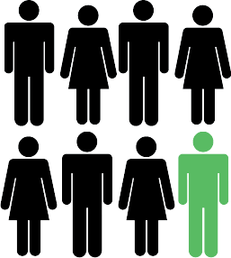
Who, what, and why?
Dyslexia
Linked with ADHD, anxiety, and depression (Hendren et al., 2018)
ADHD
80% of adults have at least 1 psychiatric disorder (Katzman et al., 2017)
ASD
Often occurs with anxiety and depression (APA, 2013)
1 in 8 people are considered Neurodiverse
(Sargent, n.d.)
Notes:
This is a very important issue because a large part of the world are neurodiverse, and mental health conditions often co-occur in neurodivergent individuals. Current estimates put that about 12.5% of the population, or 1 in 8, are considered to be neurodiverse. Further research has shown that dyslexia is often intertwined with childhood disorders found in the DSM, including “attention deficit hyperactivity disorder, anxiety and depression, [and] disruptive, impulse-control, and conduct disorders” (Hendren et al., 2018). Similarly, research on adults with ADHD have found that “as many as 80%...have at least one coexisting psychiatric disorder, including mood and anxiety disorders, substance use disorders (SUD), and personality disorders” (Katzman et al., 2017). The same goes for research on autism with, “concurrent diagnoses of autism spectrum disorder and developmental coordination disorder, anxiety disorder, [and] depressive disorder” (American Psychiatric Association, 2013, pp. 55).

Slide 8
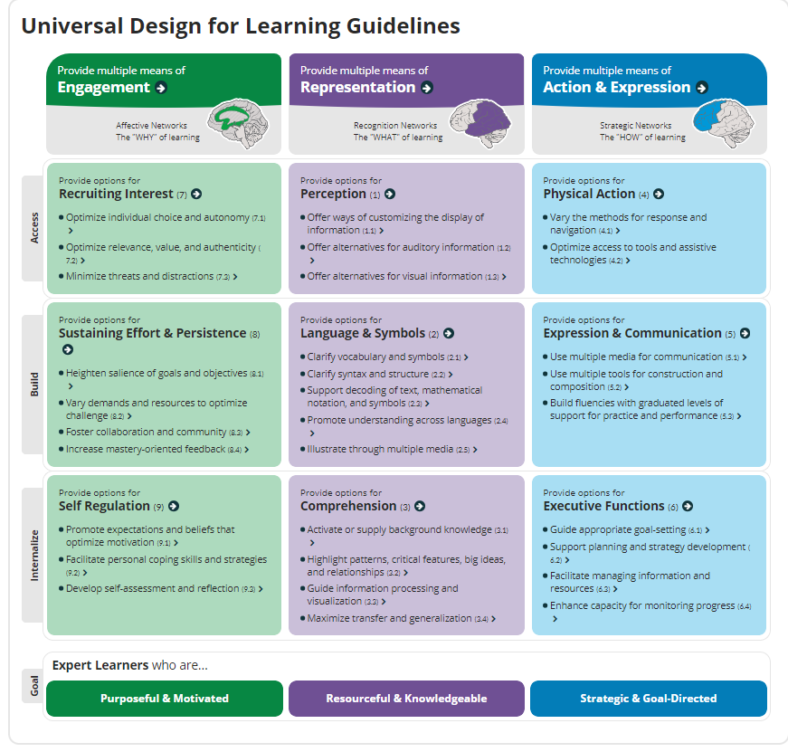
Psychology framework: UDL
Universal Design for Learning
“A set of concrete suggestions that can be applied to any discipline or domain to ensure that all learners can access and participate in meaningful, challenging learning opportunities.” (CAST 2018)
Notes:
The psychology framework I chose to apply to my project is Universal Design for Learning, or UDL. The Center for Applied Special Technology (CAST) created guidelines for universal design that are “a set of concrete suggestions that can be applied to any discipline or domain to ensure that all learners can access and participate in meaningful, challenging learning opportunities.” The main three categories that these guidelines fall into are providing multiple means of engagement, representation, and action & expression which make learning more accessible for anyone, including the neurodiverse population.

Slide 9
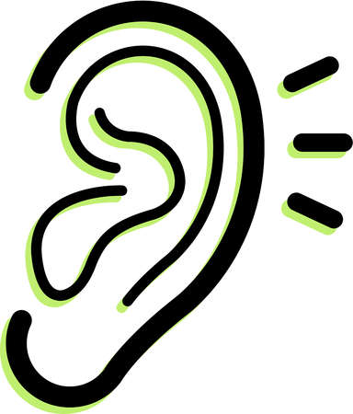
UDL Works at …
Kinesthetic Learning
Auditory Learning
Visual Learning
Notes:
Being at Landmark College, we know that Universal Design works since our entire classroom structures and teaching philosophies follow these principles that are meant to be most adaptive to those who learn differently. We see it in everything from professors providing multiple means of engagement in class by adding in different ways of teaching to suit different learning styles, for example, bringing in hands-on activities as much as possible, to the way that our classrooms are set up with every seat being on wheels for easy fidgeting.
Photo Credit:
Landmark College Logo http://catalog.landmark.edu/mime/media/5/187/landmark.png
Hands Clipart https://clipartix.com/hands-clip-art-image-38302/

Slide 10
… So why not for cbt?
Notes:
So it would make sense to apply the concept of Universal design to cognitive behavior therapy to make it more accessible for the neurodiverse population.
Picture Credit:
http://images.clipartpanda.com/psychologist-clipart-crazy-psychologist-clipart-1.jpg Psychologist Clip Art

Slide 11
application
Goals of CBT
1. Identifying troubling situations
2. Creating awareness
3. Identifying negative or inaccurate thinking
4. Reshaping these thoughts
Notes:
The Mayo Clinic identified 4 main goals for CBT: (1) identifying troubling situations or conditions in one’s life, (2) becoming aware on one’s thoughts, emotions, and beliefs about these problems or situations, (3) identifying negative or inaccurate thinking, and (4) reshaping these negative or inaccurate thoughts (2019). However, since many of these goals are accomplished both in and out of sessions, these goals can be difficult for the neurodiverse population to achieve since it does not incorporate universal design and is not adapted for this substantial percentage of people. I am going to present to you each of these goals with universally designed adaptations.

Slide 12
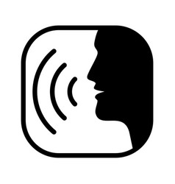
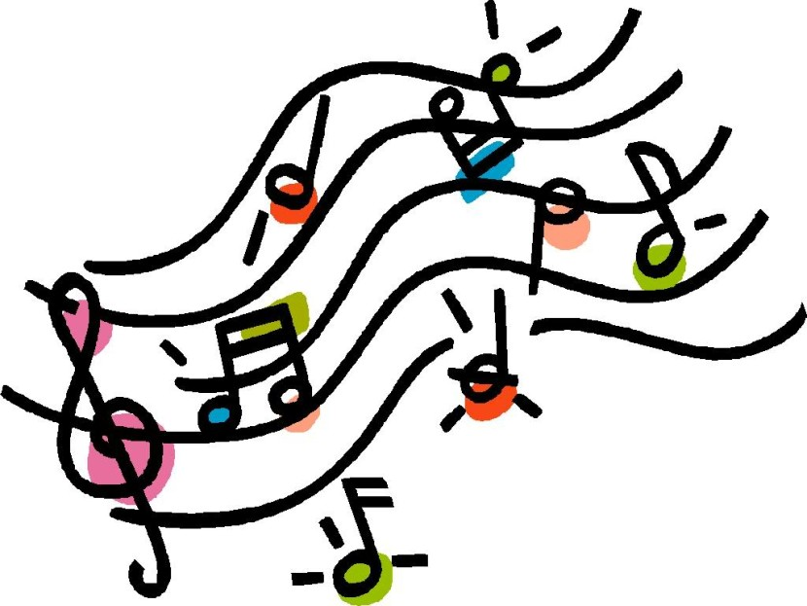
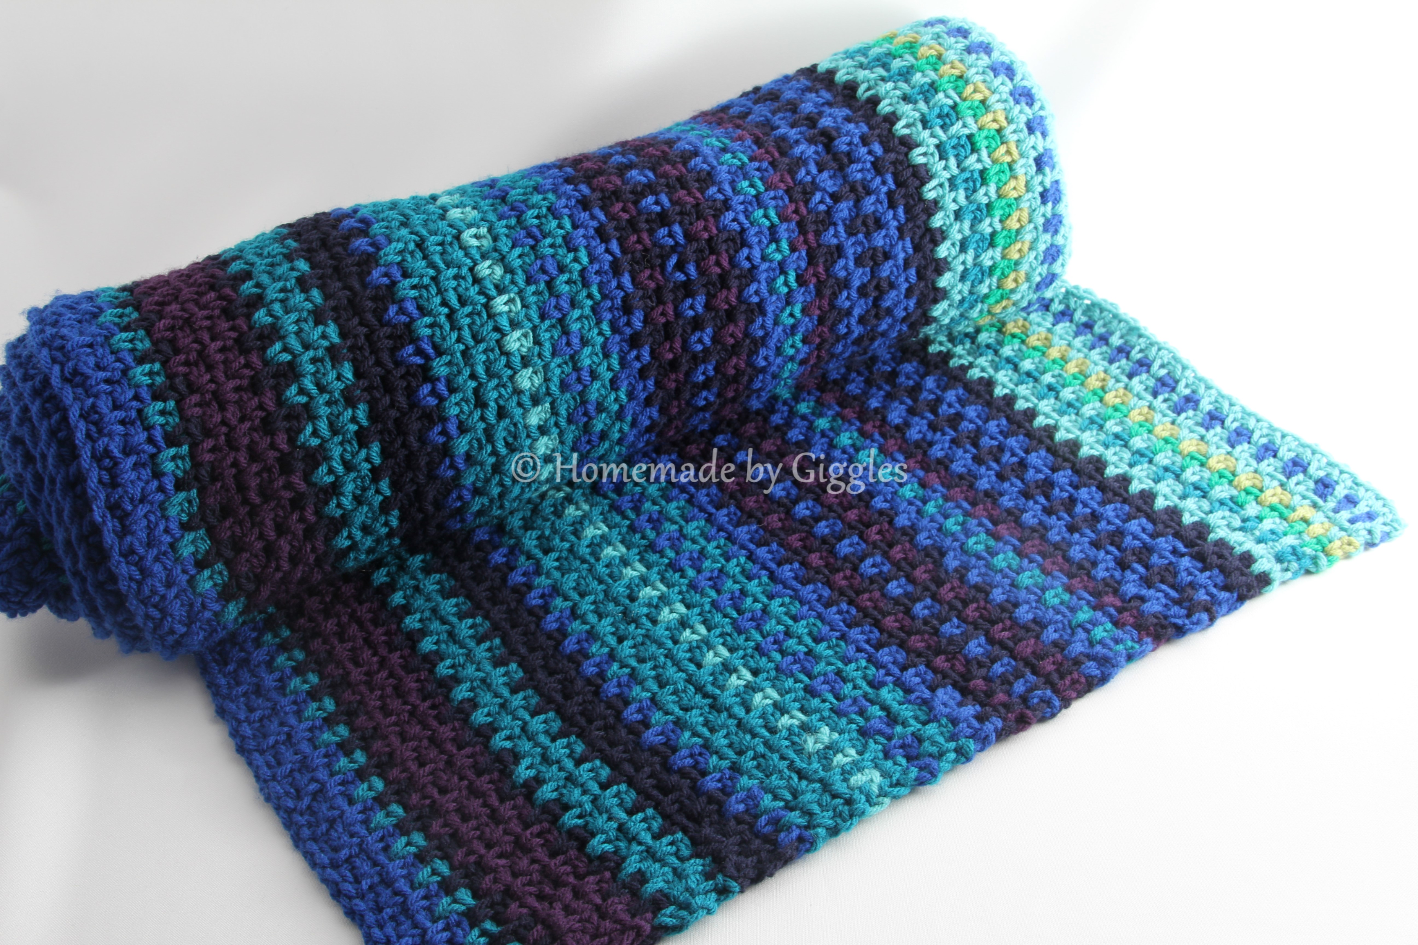
Application: identifying troubling situations
Finding Song Lyrics
Recording Voice Memos
Traditional Journaling
Taking Pictures
Creating a Mood Blanket
Notes:
One way to identify troubling situations is by recording a patient’s thoughts and feelings. This often times is done through journaling, and it can be difficult for the neurodiverse population to sit down and write about their emotions. In order to adapt universal design, I have come up with multiple alternatives to traditional journaling. For example, taking or drawing pictures, or recording voice memos can appeal to visual, kinesthetic, and auditory processors. For those who especially like to work with their hands, even creating a mood blanket by crocheting different colored yarn together which each color representing a different emotion for each day. Or, even simply finding songs with relatable lyrics to represent someone’s feelings can be helpful alternatives to traditional journaling.

Slide 13
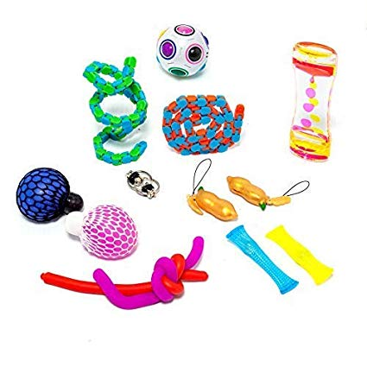
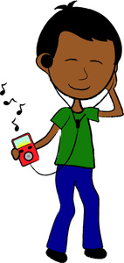
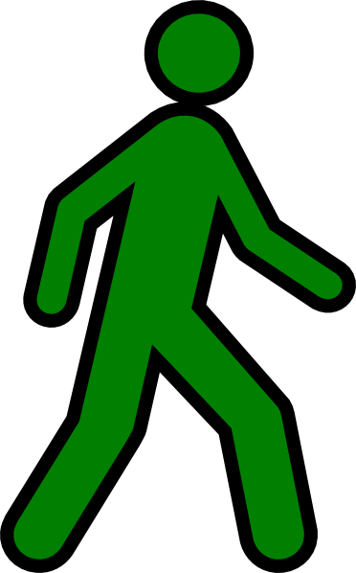
Application: Creating awareness of thoughts and emotions
Fidget Toys
Meditation
Leaving the Situation
Listening to Music
Notes:
The second goal of CBT is becoming aware of one’s thoughts and emotions about these problems or situations. In this stage, many practices may use that try to create a way to manage anxiety that comes from these thoughts, emotions and beliefs. Often times, anxiety management is meant to be something that is internalize and is not often created into something tangible, which can be beneficial to the neurodiverse community. For example, fidget toys can be used as a way to physically manipulate something kinesthetically to create almost a distraction. Meditation or count-down activities may be used to create a better mindset and to help calm the patient. It also can be helpful to instruct the individual to physically move themselves from a situation that is causing them anxiety to help create that awareness, as well as other forms of distraction, like listening to music.

Slide 14
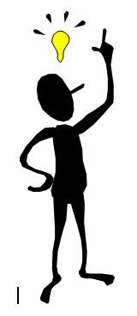
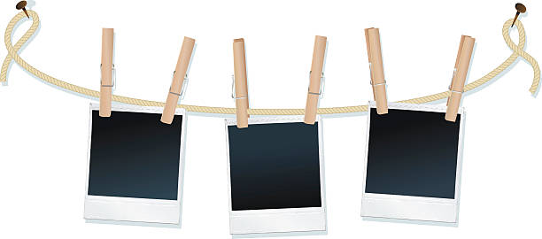
Application: reducing negative thoughts
Verbalizing Good Thoughts
Practicing Gratitude
Creating a “Good Things” Box
Notes:
There are many ways to reduce negative thoughts that incorporate universal design. Often times, reducing negative thoughts is used just as a way to change one’s mindset, but this abstract concept can be difficult for those who learn differently. To be more inclusive, activities such as verbalizing good elements of a situation, practicing gratitude, either by writing down things one is grateful more, drawing them out, taking pictures, or recording voice memos, or even creating a “good things” box, which is something that I do. I fill it with pictures, souvenirs that I have gotten from places I’ve traveled too, fun fidgets or toys to play with, and even writing down positive memories and putting them all together in one location when negative thoughts or feelings emerge.

Slide 15
Application: Reshaping negative thoughts
Exercising
Finding New Hobbies/Crafts
Watching Movies or Shows
Notes:
One way to reshape negative thoughts is to find new pleasurable activities to increase new experiences to create positive thoughts. These new activities can include things that appeal to all different types of learners with different areas of appeal. For example, one could try out a new form of exercise or exploring new places with new stimuli. Hands on learners can try new hands-on activities like building with Lego or trying out a new craft. Some other new activities could also include watching movies or finding a new show to watch.

Slide 16
limitations
Has Not Been Studied for Effectiveness
Only Focuses on Mental Health Aspects
UDL in Schools AND Therapy
Notes:
Some of the limitations of my project are that my approach has not been studied for effectiveness and it is important to note that for some neurodiverse individuals, traditional and non-adapted CBT works well for them. Another limitation is that this is only focusing on the mental health aspect of this population. For some, depression and anxiety may come from the fact that the person is neurodiverse and my approach does not work to directly mitigate these negative feelings that may coincide with this aspect, which may be helped by using universal design principles in schools as well as using it in therapies.

Slide 17
What did I learn?
BCBT Round 2?
Breaking down assignments is important
Very passionate about topic
Notes:
As for what I have learned from this project, there are many things, but looking at CBT and coming up with ways to adapt it to the neurodiverse population has made me want to try this form of psychotherapy again. I feel that I am much more equipped to advocate for what I need in order to make it be successful for me. I’ve also learned a lot about how to tackle large assignments like this project and the importance of breaking down big goals into smaller, and more attainable tasks. Lastly, I definitely have reassured myself that this is a topic that I am very passionate about and as I continue my studies in graduate school, I hope to continue looking at the intersection between neurodiversity and psychopathology to try to extend the knowledge of understanding on these two very important aspects of psychology.

Slide 18
Photo credits (in order of appearance)
Neurodiversity https://www.open.edu/openlearn/sites/www.open.edu.openlearn/files/styles/ole_ng_content_style_1000/public/ole_images/nd_fig1_2.png?itok=K0In-Ick
Students Asking Questions https://www.clipartkey.com/view/iooJhR_student-asking-question-clipart/
Psychologist Clip Art http://www.clipartpanda.com/categories/psychologist-20clipart
Psychologist Clip Art http://clipartmag.com/psychologist-clipart
DSM-5 https://www.wpspublish.com/dsm-5-diagnostic-and-statistical-manual-of-mental-disorders-fifth-edition
CDC Logo https://en.wikipedia.org/wiki/File:US_CDC_logo.svg
Mayo Clinic Logo http://menewswire.blogspot.com/2011/06/mayo-clinic-researchers-use-human.html
Beck Institute for Cognitive Behavior Therapy Logo https://en.wikipedia.org/wiki/File:Beck_Institute_for_Cognitive_Behavior_Therapy_logo.svg
1 in 8 http://www.advanced-training.org.uk/module2/M02U11.html#
The UDL Guidelines https://udlguidelines.cast.org/?utm_source=castsite&lutm_medium=web&utm_campaign=none&utm_content=aboutudl

Slide 19
Landmark College Logo http://catalog.landmark.edu/mime/media/5/187/landmark.png
Hands Clip Art https://clipartix.com/hands-clip-art-image-38302/
Listening Ears Clip Art http://cliparts.co/clipart/2492532
Visual Clip Art https://clipground.com/images/visual-clipart-4.jpg
Office Chair Clip Art http://cliparts.co/clipart/2358985
Colorful Natural Tree Vector Clip Art https://www.goodfreephotos.com/vector-images/colorful-natural-tree-vector-clipart.png.php
Audio Book Clip Art http://www.clipartpanda.com/clipart_images/audio-book-clip-art-21720446
Psychologist Clip Art http://images.clipartpanda.com/psychologist-clipart-crazy-psychologist-clipart-1.jpg
Writing Clip Art https://cliparting.com/free-writing-clipart-9603/
Camera Clip Art https://www.lacrosseschools.org/longfellow-middle/home/camera-clipart-05/
Voice Vector Clip Art https://www.vectorstock.com/royalty-free-vector/voice-2-vector-32409757
Temperature Blanket http://www.homemadebygiggles.com/2017/03/03/temperature-blanket-february-summary/
Colorful Music Clip Art https://clipartion.com/free-clipart-27934/
Fidget Toys https://clipartart.com/categories/using-a-fidget-toy-clipart.html
Meditation Clip art http://www.clipartpanda.com/clipart_images/clip-art-clip-art-yoga-18197933
Walking Man Clip Art http://www.clker.com/clipart-walking-man-yellow.html

Slide 20
Music Clip Art https://www.computerclipart.com/computer_clipart_images/brown_skinned_ethnic_child_listening_to_music_0515-1003-0302-2419.html
Hesitancy Clip Art http://www.clipartpanda.com/categories/hesitancy-clipart
Gratitude Clip Art https://clipartsworld.com/img/get
Polaroid on String Clip Art https://www.istockphoto.com/illustrations/polaroid-on-string
State Shot Glasses https://www.pinterest.com/pin/483925922429531619/
Good Vibes only https://www.istockphoto.com/illustrations/good-vibes-only-motivation-poster-vector-concept
It’s All Good in the Hood Meme https://me.me/i/its-all-good-in-the-hood-memegenerator-net-its-all-good-0b72651734244b5d9967cc41f3820f60
Women Running Clip Art https://www.istockphoto.com/illustrations/woman-running
Lego Clipart https://clipartion.com/wp-content/uploads/2015/11/lego-clip-art-free-free-clipart-images1.png
Movie Clip Art https://clipartix.com/movie-clip-art/
School Clip Art https://clipartion.com/free-clipart-11311/
Task Clip Art https://openclipart.org/detail/215492/task
Question Mark Clip Art https://clipartion.com/free-clipart-1667/

Slide 21
Works cited
American Psychiatric Association. (2013). Autism Spectrum Disorder. In Diagnostic and statistical manual of mental disorders (5th ed.)
CAST (2018). The UDL Guidelines. https://www.cast.org/impact/universal-design-for-learning-udl
Hendren, R. L., Haft, S. L., Black, J. M., White, N. C., & Hoeft, F. (2018). Recognizing psychiatric comorbidity with reading disorders. Frontiers in Psychiatry, 9, 101.
Katzman, M. A., Bilkey, T. S., Chokka, P.R., Fallu, A., & Klassen, L. J. (2017). Adult ADHD and comorbid disorders: Clinical implications of a dimensional approach. BMC Psychiatry, https://doi.org/10.1186/s12888-017-1463-3
Mayo Clinic. (2019, March 16). Cognitive behavioral therapy. https://www.mayoclinic.org/tests-procedures/cognitive-behavioral-therapy/about/pac-20384610
Neurodiversity, Psychology Today. Retrieved 25 February 2021. https://psychologytoday.com/us/basics/neurodiversity
Sargent, K. (n.d.). Designing For Neurodiversity and Inclusion. Work Design Magazine. Retrieved from: https://www.workdesign.com/2019/12/designing-for-neurodiversity-and-inclusion/

Slide 22
Any questions?

